Slide 1

Notes:
Alabama has a huge opportunity, and I believe we should consider all options to make it a reality. It’s a chance to increase access to health care coverage through an Alabama-driven solution, while at the same time creating a tremendous economic impact for our state, both in terms of jobs and additional overall business activity. Plus, it’s a solution that will preserve our health care infrastructure, helping maintain access to good care for all of us.
This presentation is designed to provide a brief overview of our state’s Medicaid program, describe the current efforts to make it more efficient and effective, and provide the facts about expanding coverage.

Slide 2

Alabama Has Recruited Well
MERCEDES 1500 jobs/$253 million in incentives
HONDA 1500 jobs/$158 million in incentives
TOYOTA 350 jobs/$29 million in incentives
HYUNDAI 2,000 jobs/$253 million in incentives
AIRBUS 1,000 jobs/$158 million in incentives
(NOTE: Need sources)
Notes:
First, if we look at expanding coverage from an economic standpoint, it’s a really good investment, particularly when you consider what we’ve spent to create other jobs. This slide provides the initial jobs and incentives provided to attract several major manufacturing companies.
In total, the number of jobs equal about 6,300, and the cost to create them was $851 million.

Slide 3

Alabama Has A Huge Opportunity
For about $700 million over the next six years, we can create approximately 30,000 jobs by increasing Medicaid coverage.
The additional $28 billion in economic activity will more than cover the $700 million cost, leaving a net of $900 million.
This can be done without a major recruitment campaign, simply with the stroke of a pen.
Notes:
Alabama has the opportunity to expand it’s Medicaid program to cover more individuals. And because the federal government would pick up the tab for most of the costs of the expansion, it’s estimated that this would bring about $12 billion in federal funds to our state over a six-year period. This slide demonstrates the value of that investment to our economy.

Slide 4

How can we do this?
By leveraging our tax dollars that have already been sent to Washington, D.C.
By increasing health coverage to Alabamians through an Alabama-driven solution to the Medicaid program.

Slide 5
What is Medicaid?
It’s a federal/state program that pays for medical care for people with low incomes and limited resources.
      38 percent of Alabama’s children are covered by Medicaid
      53 percent of all deliveries are covered by Medicaid
      Two-thirds of nursing home care is supported
      by Medicaid
      More than 40 percent of Medicaid expenditures pay for care for those who are blind or disabled
Notes:
Before we talk more about increasing coverage, I’d like to share a little bit about the Medicaid program.

Slide 6
Medicaid Addresses Health Challenges
 | Alabama | US Average
Infant Mortality per 1,000 live births | 9.2 | 6.6
Life Expectancy at Birth | 75.4 | 78.9
Teen Death Rate per 100,000 teens | 120 | 88
Overweight or Obese Children (10 – 17) | 35% | 31.3%
Overweight or Obese Adult | 66.8% | 63.3%
People who Report a Disability | 15.5% | 10.4%
Adult Diabetes | 11.8% | 8.7%
Deaths due to Heart Disease per 100,000 Pop. | 236 | 179.1
Adults who Smoke | 24.3% | 20.1%
Notes:
Alabama is often at the bottom of the national lists in terms of having a healthy population. You can see from this chart how our statistics compare to the national average. Medicaid plays a pivotal role in addressing many of the health care needs, providing preventive care, rather than more costly acute care if conditions were left untreated.

Slide 7
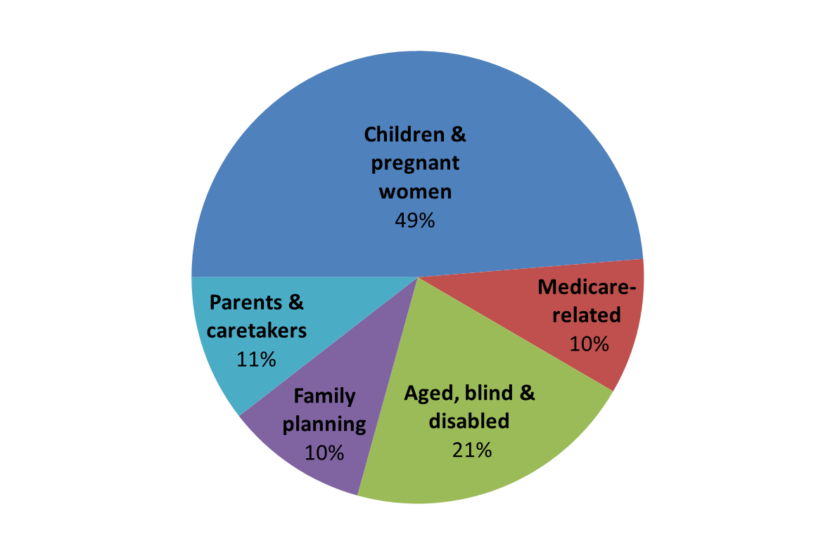
More About Who Is Covered
Alabama Medicaid Enrollment by Category FY 2011
Notes:
Most people are surprised to learn who is covered by Medicaid. The program has very strict eligibility requirements and does not cover those most people think about. It primarily covers children, the disabled and seniors. It does not cover any adult under 65 unless they have a child, and even then the eligibility is so low that most of them are not eligible.

Slide 8
Alabama’s Program: Bare Minimum
Alabama’s eligibility levels are among the most stringent in the country:
      No childless adult is eligible. Adults with children (family of four) are only eligible if they make less than $4368 a year.
      Children under age 18 are eligible if they live in families of four with a household income of less than $35,412.
Only the minimum services are covered:
      Basically, the only optional benefits covered are prescription medications, hospice, prosthetics and eyeglasses for adults and kidney dialysis.
Notes:
Since the beginning, Alabama’s Medicaid program has been designed to offer the minimum benefits and enrollment required by the federal government to receive the matching federal funds. Just to clarify, the amounts listed above are annual amounts. For example, an adult cannot make more than $2300 a year, or a little more than $6 a day for a family of four. So, in other words, almost no adults under 65 are eligible, unless they have a disability.
There are very few optional programs covered by the Agency, and the ones that are covered are not considered optional by most and if removed would significantly increase the cost for all other services.
The Agency has also operated very efficiently from an administrative standpoint, with about a 4.3 percent overhead.

Slide 9
Medicaid Provides Access To Care
Many local hospitals and physicians, particularly those in rural areas, depend on the Medicaid patient volume to stay in business:
        30 – 40 percent of pediatricians’ patients are covered
        by Medicaid.
        60 percent of Children’s Hospital of Alabama patients are covered by Medicaid, and many rural hospitals have high volumes of Medicaid patients.
        Almost 70 percent of nursing home patients are covered by Medicaid.
Notes:
You may not realize how much some providers depend on Medicaid patients as a key portion of their business. In some areas the Medicaid volume may be what keeps a pediatrician in that community or maybe a local hospital. So, by having a strong Medicaid program, we ensure access to health care for all of us.

Slide 10
Medicaid Faces Tough Challenges
Our minimal program barely meets federal Maintenance of Effort requirements.
We leave many critical health needs of Alabamians unaddressed.
We face a significant funding shortfall – patched in the short term by voter approval to transfer funds from the Oil & Gas Trust Fund.
We have a shortage of primary care physicians, exacerbated by continued cuts in Medicaid reimbursement.
The program lacks incentives for coordinating care.
Notes:
Most of us would agree that while we’ve done the best that we could with the limited dollars available, the program is in need of reform.

Slide 11
Gov. & Legislature Initiate Reform
The Governor’s Medicaid Advisory Commission recommended a framework for reform that:
      Ensures continued access to existing services
      Revises payment incentives to place risk at the community level and bend cost curve for state
      Promotes prevention and coordinated care
Notes:
The Medicaid Advisory Commission included not only lawmakers, but also representatives of state agencies, provider groups, consumers, insurers and businesses. The Commission suggested a framework that would better manage the care through community-led organizations.

Slide 12
Reform Continued…
Legislature passed bill establishing reform framework:
        State divided into 5 regions based on where Medicaid recipients receive their care.
        Regions will be paid a per-person amount to provide health care for all Medicaid recipients in the region.
        Regions must be operational by October 2016.
Notes:
Basically, the reform places the risk for providing Medicaid services at the community level in an effort to incentivize better coordination of care, encourage efficiencies and provide the state with fiscal certainty.

Slide 13












CARE MANAGEMENT TEAM
Primary Care Physician
& Care Coordinator
Data Portals
Patient
Tailored Care Planning
Coordination of Care
Improved Access
Improved Communication
Behavioral Health
Aggregated
Clinical Information
Event Notification
Alerts & Reminders
Chronic Disease
Management Tools
Specialist
RCO
Acute
Sub-Acute
Notes:
Here’s a way to picture how the new model might look. The patient is in the center with her primary care physician and care coordinator and lots of information. The care coordinator and physician then help coordinate all other care to avoid duplication, ensure appropriate care and enhance the flow of information from provider to provider.

Slide 14
With Reform Comes Opportunity
Currently, Alabama only covers adults with children and only those who are at less than 12 percent of the federal poverty level.
The expansion would allow a family of four to make up to $31,000 annually and still qualify.
The federal government would cover 100 percent of the costs of increasing coverage for the first three years.
The most the state would ever pay is 10 percent of the expansion cost starting in 2020.

Slide 15
With Reform Comes Opportunity
Medicaid expansion is only an expansion of coverage, not an increase in benefits.
If, for any reason, the state decides it can no longer support the expanded population, it can opt out.
Medicaid reform, coupled with a Medicaid coverage increase, would allow us to design an Alabama-based health system that would meet the unique needs of our citizens.

Slide 16
State-Based Solutions
States across the country are developing state-based solutions to increase access to health coverage.
      Arkansas
      Pennsylvania
      Iowa
Alabama lawmakers need to find their own solution for our state.
Notes:
Arkansas, in particular, has developed a new program that increases the number of individuals eligible for coverage, by using the federal dollars to purchase private coverage.

Slide 17
Tremendous Economic Potential
Two credible, university studies have reported on the huge economic potential of an expansion.
They predict the additional payments for newly eligible individuals will drive increased health care demand, which will result in additional tax revenue, utility utilization, equipment and supply purchases, etc.
Notes:
UAB researchers from the School of Public Health did the first study in the fall of 2012, and in the fall of 2013, the Center for Business and Economic Research at the University of Alabama conducted a similar study that confirmed the economic projections of the UAB researchers and added to it the impact by industry in terms of jobs creation.

Slide 18
Tremendous Economic Potential
The University of Alabama’s Center for Business and Economic Research estimated the overall increase in business activity by $28 billion, which includes:
      $17 billion impact to state’s Gross Domestic Product
      $10 billion in worker earnings
UAB researchers found that the additional taxes and economic benefits would more than cover the state’s cost of the expansion… about $700 million over six years.
According to UAB study, the state would actually net about $900 million over six years.
Notes:
When you look at the numbers, if you consider the mid-range estimate of 300,000 Alabamians newly covered, it brings about $12 billion in federal dollars over the six-year period and an estimated $28 billion in business activity.

Slide 19
Covering Hardworking Alabamians
 | Potentially Eligible
Restaurants & other food services | 25,060
Construction | 23,350
Landscaping services | 6,350
Household goods repair | 5,410
Drug & chemical wholesalers | 4,880
Building support services | 4,750
Automotive repair | 4,440
Auto & related manufacturing | 3,660
Museums & historical sites | 3,520
Film & video industries | 3,450
Notes:
According to the U.S. Census statistics three out of five of those eligible for the Medicaid expansion are employed. So, having workers with access to health coverage means a more productive workforce. This chart shows the estimates of those that could be covered based on Census figures related to income levels.
Here is a list of the top 10 industries and the estimated number of individuals in that industry that would benefit from an expansion of Medicaid coverage.

Slide 20
Potential for 30,000 jobs!
  11,290 in health care/social assistance
  6,390 in retail trade
  5,490 in professional, scientific and technical services
  1,523 in administrative and support services
  1,247 in accommodations and food services
  1,095 in finance and insurance
Notes:
Because of the need for additional jobs in health care, jobs are created in other industries as a result of the health care jobs. All industries receive some type of benefit, but these are the industries that would benefit the most from the jobs creation.

Slide 21
Investments in Jobs Creation
Mercedes: $253 million for 1500 jobs
      Cost of $168,166 PER JOB
Hyundai: $253 million for 2000 jobs
      Cost of $126,400 PER JOB
Medicaid expansion would cost $777 million
for 30,800 jobs
      COST OF $25,000 PER JOB
Notes:
If you look at what the state has spent on recruiting other industries, the Medicaid expansion is huge in comparison. The cost over six years is estimated to be $777 million, but that nets the state more than 30,000 jobs.
So, the state can invest 15 percent of what it spent to recruit Mercedes and gain 30,000 jobs and provide much-needed health coverage for almost 300,000 Alabamians.

Slide 22
What happens if we don’t expand?
Hundreds of thousands of Alabama’s adults will not receive health coverage.
30,000 new jobs will go by the wayside.
The state will lose billions in economic impact.
Hospitals will be forced to cut services or perhaps close as the supplemental payments for the uninsured are cut.
Notes:
The thought behind those who drafted the Affordable Care Act is that with the expanded population, hospitals would no longer need the supplemental payments (DSH payments) they receive to care for the uninsured. However, without an expanded program, Alabama’s hospitals will see significant reductions in DSH payments without the corresponding increase in insured patients.

Slide 23
What happens if we don’t expand?
The cost of caring for the uninsured will continue to affect all of us through increased premiums due to cost shifting. One study estimates that in Alabama the effect of uninsured costs amount to $210 a year for individual premiums and $600 a year for family premiums.
Millions of Alabama tax dollars will be spent in other states, such as California or New York. These are taxes already being collected that will not go away.

Slide 24
Alabamians Will be Caught in a Gap
Alabamians making less than the federal poverty level are not eligible for subsidies to purchase coverage through the insurance exchange.
Those from 100 percent of FPL to 133 percent would be eligible for subsidies, but likely could not afford to purchase coverage.
Those caught in the gap number 191,000 and represent 36 percent of the state’s non-elderly uninsured.

Slide 25
Bottom Line: Expansion Makes Sense
We’re reforming our Medicaid program to improve care and make it more cost efficient. So we should be ready to increase coverage.
Medicaid expansion would provide health coverage to an estimated 300,000 Alabamians.
If we don’t expand, we leave on the table:
    30,000 new jobs
    $12 billion in federal funding
    $28 billion in economic impact
    The potential for an Alabama solution to the coverage challenge

Slide 26
Start the Conversation
Visit ALABAMASBEST.ORG to read more about the Medicaid expansion and its potential economic impact.
Share this information with your friends and neighbors.
Ask your elected leaders to join in the conversation with providers, advocates, and business leaders about what is best for Alabama, our citizens, and our economy.
Encourage the Governor and the Legislature to develop Alabama’s BEST option for the Medicaid program.

