Slide 1

One of our Community’s Most Valuable Resources …
Your Local Hospital

Slide 2

Keeping Alabama Healthy
Alabama hospitals are proud to provide care to our communities 24 hours a day, 7 days a week, 365 days a year.
Every year, we serve thousands of individuals and support other medical infrastructure, such as doctor’s offices, home health agencies … health services that are not often available in communities without a hospital. These services are provided regardless of the ability to pay.
This record of service is, and always will be, our most valuable contribution to the communities we serve.

Slide 3
Caring for all Alabamians
Hospital Patients | Alabama | (Your hospital)
Births | 56,038 | ___
Emergency Department Visits | 2.3 mil | ___
Inpatient Stays | 625,425 | ___
Outpatient Visits | 6.4 mil | ___
Outpatient Surgeries | 410,937 | ___

Slide 4
Keeping Alabama’s Economy Healthy
Hospitals are critical to the economic viability of communities:
  Often the largest employer in a community, providing jobs for people who buy other services, pay taxes, etc.
  One of the community’s largest purchasers of goods and services
  Provide health care services that result in a better quality of life and a healthy, productive workforce

Slide 5
Providing Jobs
Alabama’s hospitals employ more than 80,000 people and indirectly support 78,000 jobs in other industries, for a total of 158,000 jobs.
Alabama’s hospitals provide approximately $4 billion in salaries and benefits for employees and another $2.7 billion indirectly for a total of $6.7 billion in labor income.
Our hospital employs ____ people and indirectly supports ___ jobs in other industries, for a total of ___ jobs.
Our hospital provides ____ in salaries and benefits for our employees and another ___ indirectly for a total of ____ in labor income for our community.
Notes:
Hospitals are often the largest employer in a community. Nationally, it’s the second largest source of private sector jobs. Not only do hospitals provide a good number of jobs, but these jobs utilize all types of skills, including a number of highly skilled positions.
And, for every one job created by a hospital, another 0.98 jobs are created in other businesses. Multiply total full and part time jobs by 0.9758 to get additional jobs created.
And, the labor income is also multiplied. (To calculate the additional labor income, multiply your hospital’s salaries and benefits by 0.6621.

Slide 6
Economic Impact in my Community
The goods and services hospitals purchase from other businesses create additional economic value for the community.
Alabama’s hospitals are a huge economic driver for our state, creating an estimated $17.9 billion in economic impact each year.
The economic impact of our hospital on this community is estimated to be ____.
Notes:
Multiply net patient revenue plus other operating revenue by 1.9923 to get estimate of total economic impact.

Slide 7
Alabama’s Hospitals Are Efficient
In the first year of value-based purchasing, Alabama ranked number one in quality improvement and performance.
Alabama’s hospitals reduced blood stream infections by 53 percent in two years, saving an estimated $4.8 million.
Hospital care as a percent of national spending has declined from 43 percent in 1980 to 33 percent in 2009.
13th lowest cost per discharge in the country
Notes:
Declining healthcare costs figure comes from 2011 AHA TrendWatch.
Cost per discharge and net patient revenue statistics come from Cleverly and Associates 2013 report (data from 2011).

Slide 8
Doing More with Less
In a 2010 survey, the average total margin for Alabama’s hospitals was 1 percent.
In that survey 41 hospitals had negative margins with the lowest margin being negative 19 percent.
The following year, 53 out of 94 hospitals had negative total margins.
Notes:
Declining healthcare costs figure comes from 2011 AHA TrendWatch.
Cost per discharge and net patient revenue statistics come from Cleverly and Associates.

Slide 9
Who are our Patients?

Slide 10
What is Medicaid?
It’s a federal/state program that pays for medical care for people with low incomes and limited resources.
      38 percent of Alabama’s children are covered by Medicaid
      53 percent of all deliveries are covered by Medicaid
      Two-thirds of nursing home care is paid for
      by Medicaid
      More than 40 percent of Medicaid expenditures pay for care for those who are blind or disabled
Notes:
Since today’s talk is about Medicaid the need to expand health insurance coverage, let’s look a little closer at the Medicaid program.

Slide 11
Alabama’s Program: Bare Minimum
Alabama’s eligibility levels are among the most stringent in the country:
      No childless adult is eligible. Adults with children (family of four) are only eligible if they make less than $4368 a year.
      Children under age 18 are eligible if they live in families of four with a household income of less than $35,412.
Only the minimum services are covered:
      Basically, the only optional benefits covered are prescription medications, hospice, prosthetics and eyeglasses for adults and kidney dialysis.
Notes:
Since the beginning, Alabama’s Medicaid program has been designed to offer the minimum benefits and enrollment required by the federal government to receive the matching federal funds. Just to clarify, the amounts listed above are annual amounts. For example, an adult cannot make more than $2300 a year, or a little more than $6 a day for a family of four. So, in other words, almost no adults under 65 are eligible, unless they have a disability.
There are very few optional programs covered by the Agency, and the ones that are covered are not considered optional by most and if removed would significantly increase the cost for all other services.
The Agency has also operated very efficiently from an administrative standpoint, with about a 4.3 percent overhead.

Slide 12

Medicaid Provides Access To Care
Many local hospitals and physicians, particularly those in rural areas, depend on the Medicaid patient volume to keep their doors open:
        30 – 40 percent of pediatricians’ patients are covered
        by Medicaid.
        60 percent of Children’s Hospital of Alabama patients are covered by Medicaid.
        Most rural hospitals have high volumes of Medicaid patients.
        Almost 70 percent of nursing home patients are covered by Medicaid.
Notes:
You may not realize how much some providers depend on Medicaid patients as a key portion of their business. In some areas the Medicaid volume may be what keeps a pediatrician in that community or maybe a local hospital. So, by having a strong Medicaid program, we ensure access to health care for all of us.

Slide 13
Major Reforms to Current Program
During the 2013 legislative session, a law was passed that will significantly reform the Medicaid program to better manage all aspects of the program into the future, including cost and care delivery.
This coordination will better utilize the limited resources Alabama has available and will place the financial risk for the care provided at the community level, thus ensuring financial stability for the state.
This reform has prepared Alabama to take the next step and design an Alabama-driven solution to the coverage challenge.
Notes:
The law was based on the work of a Medicaid Advisory Commission that included not only lawmakers, but also representatives of state agencies, provider groups, consumers, insurers and businesses. The Commission suggested reform that would better manage the care through community-led organizations that would:
Ensure continued access to existing services
Revise payment incentives to place risk at the community level and bend cost curve for state
Promote prevention and coordinated care by better connecting providers and ensuring all patients have a medical provider directing their care.
The legislation provides for:
State to be divided into 5 regions based on where Medicaid recipients receive their care
Regions will be paid a per-person amount to provide health care for all in the region
Regions must be operational by October 2016

Slide 14











Medicaid’s Focus: Coordinated Care
CARE MANAGEMENT TEAM
Primary Care Physician
& Care Coordinator
Data Portals
Patient
Tailored Care Planning
Coordination of Care
Improved Access
Improved Communication
Behavioral Health
Aggregated
Clinical Information
Event Notification
Alerts & Reminders
Chronic Disease
Management Tools
Specialist
RCO
Sub-Acute
Acute
Notes:
Here’s a way to picture how the new model might look. The patient is in the center with her primary care physician and care coordinator and lots of information. The care coordinator and physician then help coordinate all other care to avoid duplication, ensure appropriate care and enhance the flow of information from provider to provider.

Slide 15
With Reform Comes Opportunity
Alabama, like other states, has an opportunity to increase the number of individuals eligible for health coverage through Medicaid up to 133 percent of the federal poverty level (approximately $31,000 a year for a family of four).
This increase would only apply to adults and would not increase the benefits, just the individuals eligible.
The federal government would cover 100 percent of the costs for the first three years, and the most the state would ever pay is 10 percent of the expansion cost starting in 2020.

Slide 16
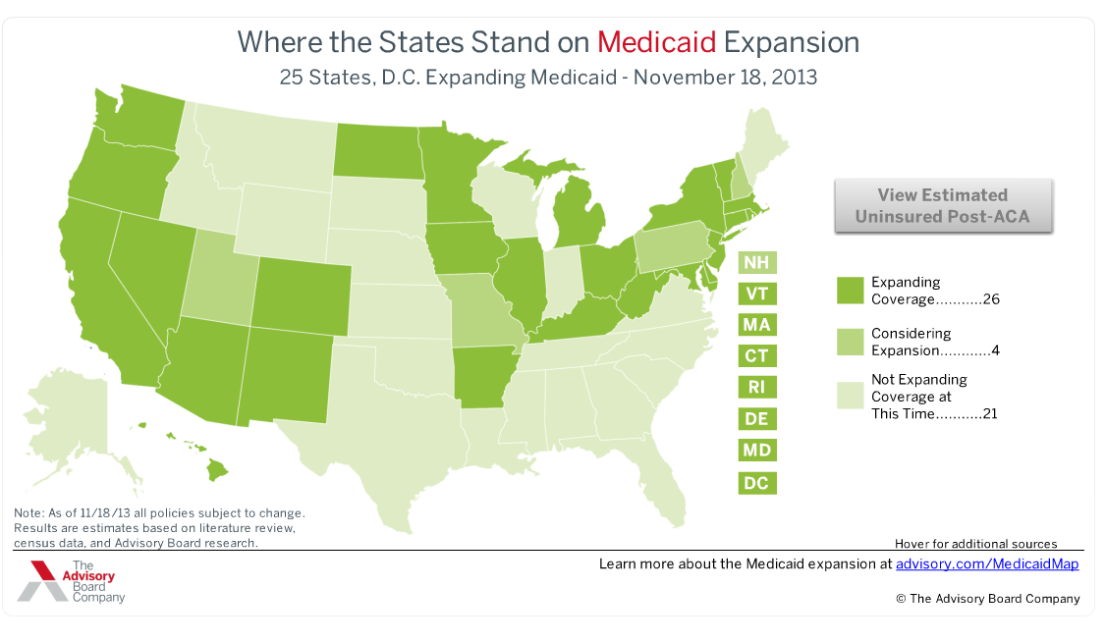
State-Based Solutions
Notes:
States across the country are developing state-based solutions to increase access to health coverage.
(Arkansas, Pennsylvania, Iowa, Indiana)
Half of all states have committed to an expansion. Several others are considering it.
Alabama lawmakers need to find their own solution for our state.
Arkansas, in particular, has developed a new program that increases the number of individuals eligible for coverage, by using the federal dollars to purchase private coverage. Pennsylvania and Iowa have built wellness components into their plans. Indiana’s proposal promotes personal responsibility through health savings accounts for some higher income eligibles.

Slide 17
An Alabama-Driven Solution would:
  Address the state’s under and uninsured.
  Keep Congress from spending our $12 billion in taxes on other things.
  Minimize the detrimental effects—taxes, fees, reduced hospital and physician payments—of the Affordable Care Act on Alabama.
  Allow the state to design a solution based on free market principals that protects the doctor/patient relationship while utilizing the federal funds available.

Slide 18
Tremendous Economic Potential
The University of Alabama’s Center for Business and Economic Research estimated the overall increase in business activity by $28 billion, which includes:
      $17 billion impact to state’s Gross Domestic Product
      $10 billion in worker earnings
UAB researchers found that the additional taxes and economic benefits would more than cover the state’s cost of the expansion… about $700 million over six years.
According to UAB study, the state would actually net about $900 million over six years.
Notes:
UAB researchers from the School of Public Health did the first study in the fall of 2012, and in the fall of 2013, the Center for Business and Economic Research at Alabama conducted a similar study that confirmed the economic projections of the UAB researchers and added to it the impact by industry in terms of jobs creation.
One of the questions raised about the jobs creation is where would the additional workers come from if there’s already a shortage of health care professionals. We know there would definitely need to be additional health care workers, even with the reform efforts to drive greater efficiency.
The Medicaid expansion would provide the needed funding to recruit additional professionals.
When you look at the numbers, if you consider the mid-range estimate of 300,000 Alabamians newly covered, it brings about $12 billion in federal dollars over the six-year period and an estimated $28 billion in business activity.

Slide 19
Covering Hardworking Alabamians
 | Potentially Eligible
Restaurants & other food services | 25,060
Construction | 23,350
Landscaping services | 6,350
Household goods repair | 5,410
Drug & chemical wholesalers | 4,880
Building support services | 4,750
Automotive repair | 4,440
Auto & related manufacturing | 3,660
Museums & historical sites | 3,520
Film & video industries | 3,450
Notes:
According to the U.S. Census statistics three out of five of those eligible for the Medicaid expansion are employed. So, having workers with access to health coverage means a more productive workforce. This chart shows the estimates of those that could be covered based on Census figures related to income levels.
Here is a list of the top 10 industries and the estimated number of individuals in that industry that would benefit from an expansion of Medicaid coverage.

Slide 20
Potential for 30,000 jobs!
  11,290 in health care/social assistance
  6,390 in retail trade
  5,490 in professional, scientific and technical services
  1,523 in administrative and support services
  1,247 in accommodations and food services
  1,095 in finance and insurance
Notes:
Because of the need for additional jobs in health care, jobs are created in other industries as a result of the health care jobs. All industries receive some type of benefit, but these are the industries that would benefit the most from the jobs creation.

Slide 21
Past Investments in Job Creation
Mercedes: $253 million for 1500 jobs
      Cost of $168,166 PER JOB
Hyundai: $253 million for 2000 jobs
      Cost of $126,400 PER JOB
Medicaid expansion would cost $777 million
for 30,800 jobs
      COST OF $25,000 PER JOB
Notes:
If you look at what the state has spent on recruiting other industries, the Medicaid expansion is huge in comparison. The cost over six years is estimated to be $777 million, but that nets the state more than 30,000 jobs.
So, the state can invest 15 percent of what it spent to recruit Mercedes and gain 30,000 jobs and provide much-needed health coverage for almost 300,000 Alabamians.

Slide 22
What happens if we do nothing?
Millions of Alabama tax dollars will be spent in other states such as California or New York.
300,000 adult Alabamians will not receive coverage.
The of the uninsured will continue to affect all of us through increased premiums due to cost shifting.
30,000 new jobs will go by the wayside, meaning the state will lose billions in new economic activity.
Alabama will lose the opportunity to design a solution that meets the needs of our citizens.
Notes:
Just because expansion became optional, the taxes created to pay for it did not. Alabamians will pay them, but not see any benefit.
you might ask what they would think if the government mandated that all automobile manufacturers had to provide cars for those who could not afford to pay for them and then didn’t offer the manufacturers any subsidy to cover the expense.
The thought behind those who drafted the Affordable Care Act is that with the expanded population, hospitals would no longer need the supplemental payments (DSH payments) they receive to care for the uninsured. However, without an expanded program, Alabama’s hospitals will see significant reductions in DSH payments without the corresponding increase in insured patients.

Slide 23
Opting Out of Medicaid Expansion will Negatively Impact Hospitals
The Affordable Care Act cut hospital payments for uninsured patients, anticipating that more people would have coverage.
If Alabama does nothing, 300,000 people will remain uninsured, and the cuts will still be imposed.
Without either, hospitals will be in dire straits.
Notes:
The thought behind those who drafted the Affordable Care Act is that with the expanded population, hospitals would no longer need the supplemental payments (DSH payments) they receive to care for the uninsured. However, without an expanded program, Alabama’s hospitals will see significant reductions in DSH payments without the corresponding increase in insured patients.

Slide 24
Specifics about Hospital Payment Cuts
Currently, hospitals receive some supplemental payments from Medicare and Medicaid, called DSH payments. These payments are designed to offset the cost of providing care to the uninsured.
Because the Affordable Care Act provided a means for additional coverage, it imposed DSH cuts.
These cuts equal about $16 million in Alabama this year, $32 million in the next fiscal year and likely could go as high as $200 million in 2020.
Notes:
These cuts started on October 1, 2013.
According to the most recent survey by the Alabama Hospital Association, hospital margins are extremely thin. On average about 1 percent. Any significant reductions in payments could result in hospitals having to make tough decisions about staffing, services or in the worst case scenario about whether or not to close.

Slide 25
Bottom Line: Expansion Makes Sense
We’re reforming our Medicaid program to improve care and make it more cost efficient. So we should be ready to increase coverage.
Medicaid expansion would provide health coverage to an estimated 300,000 Alabamians.
If we don’t expand, we leave on the table:
    30,000 new jobs
    $12 billion in federal funding
    $28 billion in economic impact
    The potential for an Alabama solution

Slide 26
Start the Conversation
Visit ALABAMASBEST.ORG to read more about the Medicaid expansion and its potential economic impact.
Share this information with your friends and neighbors.
Ask your elected leaders to join in the conversation with providers, advocates, and business leaders about what is best for Alabama, our citizens, and our economy.
Encourage the Governor and the Legislature to develop Alabama’s BEST option for the Medicaid program.

